Slide 2
Issues to be discussed
Economic thinking and legal thinking
The scope of competition law: unfair practices, anticompetitive practices
Economic elements useful in competition law
Economic issues in assessing anticompetitive agreements
Economic issues in assessing the conduct of dominant firms
Relevance for Hong Kong competition law
Damages from anticompetitive practices
Ten principles to follow when presenting economic evidence to courts
How to facilitate the economic undertanding of courts ,
Conclusion

Slide 3
The Challenge
“I speak only for myself, and I do so without criticising anybody, but I have to say, I have never listened to evidence in any court for an hour and understood so little of it as I have understood during the last hour. It may all be as clear as daylight to my colleagues.
“All I can say is that anybody who really wants to make sure that I understand and have the ability to make an evaluation of this kind of material that we have has a very long way to go in educating me as to how I should deal with it. (….) I will sit here quietly and let it all wash over me for a reasonable amount of time, but I think that those who are asking the court to rely on this must be under no illusions that at the moment, so far as I am concerned, this is all washing over my head”.
Mr Justice Ferris, UK, 1999 case against the joint selling of television rights by Premier
League football club

Slide 4
Economic methodology

Slide 5
Some differences between the judicial and the economic prespectives
Economic perspective
Judicial perspective
Goal(s) of the law
What the Law Says
Relevant facts
What happened
Theory of harm
Applicability of general legal principle
Indirect evidence
Direct evidence
Correlation
Causality
Type I / Type II errors
Standard of proof
Deterrence
Proportionality
Optimality
Predictability
Economic harm
Legal prejudice
Economic jargon
Legal jargon

Slide 6
Issues to be discussed
Economic thinking and legal thinking
The scope of competition law: unfair practices, anticompetitive practices
Economic elements useful in competition law
Economic issues in assessing anticompetitive agreements
Economic issues in assessing the conduct of dominant firms
Relevance for Hong Kong competition law
Damages from anticompetitive practices
Ten principles to follow when presenting economic evidence to courts
How to facilitate the economic undertanding of courts ,
Conclusion

Slide 7
Limitations on business practices
- Anticompetitive practices forbidden by competition law ( anticompetitive practices):
ex: price fixing,
ex: market sharing,
ex: tying, bundling, predatory pricing ,
ex:abuse of dominance etc….

Slide 8
Limitations of business practices
- Unfair competition :
Ex:
1) diversion of a competitor’s customers through means other than competition on the merits (such as hiring away the competitor’s employees, inducing the competitor’s employees to leak strategic documents of their employer such as customer lists, business plans and other records);
2) attempts to induce selective dealers of a competitor into breaches of contracts or exploitation of a breach of contract or covert acquisition of a branded good by dealers not part of the distribution system of the manufacturer of the branded goods;
3) dissemination of unjustified derogatory comments about a competitor’s ability

Slide 9
Unfair trade practices are not necessarily anticompetitive practices
ex: the diversion of a competitor’s customers by unfair means (means other than competition on the merits)
may have no effect on the market if there are many competing firms
Unfair trade
practices
Forbidden if unfair
Anticompetitive
Practices
forbidden only
if anticompetitive
effect on the market

Slide 10
But unfair trade practices may also be anticompetitive practices
ex: the diversion of a competitor’s customers by unfair means (means other than competition on the merits) can be an abuse of the dominant position of the firm engaging in the practice if it prevents its only competitor from competing.
Unfair trade
practices
forbidden if unfair
Anticompetitive
Practices
forbidden only
if restrict or distort competition
effect on the market

Slide 11
Issues to be discussed
Economic thinking and legal thinking
The scope of competition law: Unfair practices, anticompetitive practices
Economic elements useful in competition law
Economic issues in assessing anticompetitive agreements
Economic issues in assessing the conduct of dominant firms
Relevance for Hong Kong competition law
Damages from anticompetitive practices
Ten principles to follow when presenting economic evidence to courts
How to facilitate the economic undertanding of courts ,
Conclusion

Slide 12
Elements of economics useful for antitrust: concepts
1) Economics can be useful to the law is in supplying various economic concepts such as “economic efficiency”, “opportunity cost”, “common costs”, “consumer surplus” « competition », etc.
An economist can advance matters by explaining their meaning.
Ex: What is predation ?
Maureen Brunt, Judicial Enforcement of Competition Law, OECD, Competition committee, 1997

Slide 13
Relevant markets
Market definition is not an end in itself but a tool to identify the strength of the competitive constraints a firm faces and to assess the existence, the creation or the strengthening of market power and the likelihood of possible anticompetitive effects.
One role of market definition in competition analysis is to provide a crude first screen to classify competitive situations, particularly mergers or abuse of dominance/monopolisation cases into those that give rise to competition concerns or even serious competition concerns and therefore justify closer scrutiny and those that do not.
.
OECD Competition committee roundtable, Market Definition 2012

Slide 14
Hypothetical monopoly economic test for market definition
Q1: Can firm A profitably increase its price permanently by 5% above the competitivel level?
If Yes
If No because consumers would switch to firm B’s products
Firm A does not face a competitive constraint .
The market is the market for product of firm A
Q2: Can firm A and B profitably increase their price permanently by 5% above the competitive level?
If No because consumers
would switch to firm C’s product
If Yes
Q3: Can firm A, B and C profitably increase their price permanently by 5% above the competitive level?
Firm A and B do not face a competitive constraint. The market is the market for products of firms A and B

Slide 15
Market power
Market power is defined as the ability of the firm to keep the price above the long-run competitive level.
A monopolist ( a firm which has no competition on a relevant market and is protected by barriers to entry has market power).
A dominant firm which has only small and weak competitors on the relevant market and is protected by barriers to entry may have market power.
The members of a cartel who act together may have collectively market power.

Slide 16
Consumer surplus
Imagine you are going to an Electronics store to buy a new flat panel TV.
Before you go to the store, you decide to yourself that you are not going to pay more than $750 for a TV. This $750 is your maximum willingness to pay for the TV.
After entering the store, you find a TV you really like for only $500! Since you were willing to pay $750 for the TV, and you only ended up paying $500 for it, you have saved $250.
This $250 is called consumer surplus by economists, because it is the “extra” or “surplus” value you received from the good beyond the price you paid for it.

Slide 17
Goal of competition law
July 2001: Mario Monti
« the goal of competition policy in all its aspects is to protect consumer welfare »
To attain this goal:
Fight against exploitative practices by firms having market power individually ( abuses of dominant position) or collectively ( anticompetitive agreements);
Fight against exclusionary practices ( which restrict competition and allow exploitative practices ) by firms having market power individually or collectively;
Merger control: prevention of mergers which result in a dominant position for the merging firms ( market power) or restrict competition;
4) Control of state aid which distorts competition.

Slide 18
Elements of economics useful for antitrust: modelling
2) the economist’s method of analysis used in applied work. This consists essentially in a combination of the inductive and the deductive to form a syllogism which purports to model reality.
The steps required are: first, to scan the raw facts (here, the raw evidence) second, to abstract the relevant facts, third, to construct a model, using available theory, which has the form: since A + B are present, C follows.
Ex: When is an exchange of information anticompetitive ?
Under which circumstances is a discount anticompetitive ?
Maureen Brunt, Judicial Enforcement of Competition Law, OECD, Competition committee, 1997

Slide 19
Elements of economics useful for antitrust: measurements
3) The third way in which economics can be useful to the law is in supplying various economic tools such as economectrics to measure the effect of allegedly anticompetitive practices”.
Ex: what was the overcharge ?

Slide 20
Issues to be discussed
Economic thinking and legal thinking
The scope of competition law: Unfair practices, anticompetitive practices
Economic elements useful in competition law
Economic issues in assessing anticompetitive agreements
Economic issues in assessing the conduct of dominant firms
Relevance for Hong Kong competition law
Damages from anticompetitive practices
Ten principles to follow when presenting economic evidence to courts
How to facilitate the economic undertanding of courts ,
Conclusion

Slide 21
Examples of economic issues in assessing agreements
1) Can economic analysis establish the existence of an anticompetitive agreement between competitors or the lack of such an agreement ( when there is parallel conduct but no direct evidence of an agreement) ?
2) Did the agreement reduce competition ?
3) Under which condition is an exchange of information between competitors anticompetitive and when does it contribute to economic progress ?
4) Could an agreement between two vertically related firms have the object or the effect of limiting competition ( in cases where there is no clear evidence of the effect) ( comparison between intra brand and interbrand competition) ?
5) Was the agreement indispensable to obtain the alleged economic progress ?
6) What was the damage inflicted by the anticompetitive agreement ?

Slide 22
Issues to be discussed
Economic thinking and legal thinking
The scope of competition law: Unfair practices, anticompetitive practices
Economic elements useful in competition law
Economic issues in assessing anticompetitive agreements
Economic issues in assessing the conduct of dominant firms
Relevance for Hong Kong competition law
Damages from anticompetitive practices
Ten principles to follow when presenting economic evidence to courts
How to facilitate the economic undertanding of courts ,
Conclusion

Slide 23
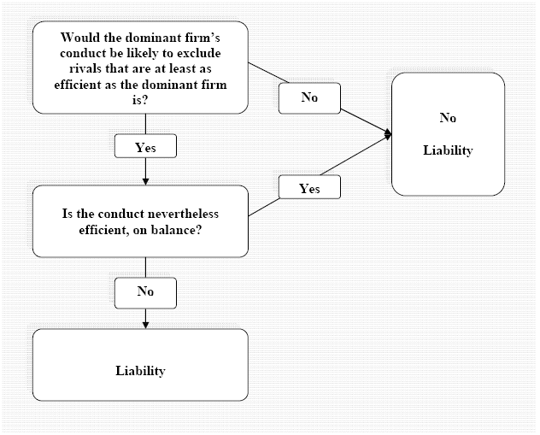
What is an exclusionary abuse of dominance: The Equally Efficient Firm Test

Slide 24
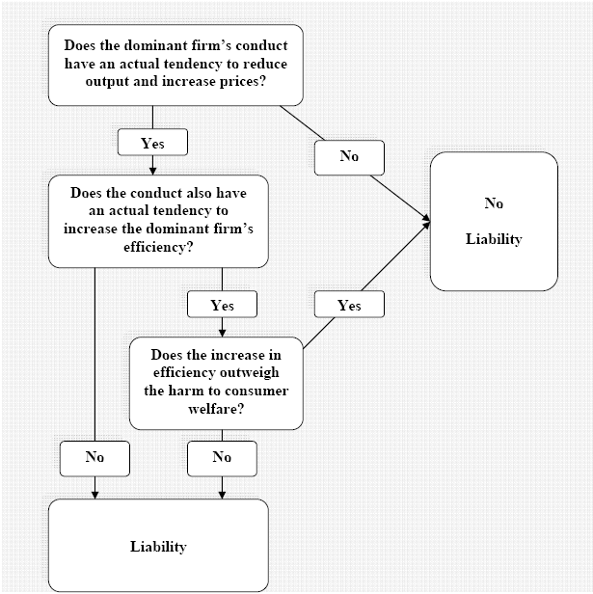
What is an exploitative abuse of dominance: the Consumer Welfare Test

Slide 25
Issues to be discussed
Economic thinking and legal thinking
The scope of competition law: Unfair practices, anticompetitive practices
Economic elements useful in competition law
Economic issues in assessing anticompetitive agreements
Economic issues in assessing the conduct of dominant firms
Relevance for Hong Kong competition law
Damages from anticompetitive practices
Ten principles to follow when presenting economic evidence to courts
How to facilitate the economic undertanding of courts ,
Conclusion

Slide 26
Hong Kong: do unfair practices fall under the second conduct rule
During the consultation process on the Guidelines, there were queries on whether "exploitative conduct" as used in the Telco Rule, such as the imposition of unfair prices or other unfair trading conditions, also falls within the scope of the Second Conduct Rule.
(….)Any conduct which has the object or effect of preventing, restricting or distorting competition in Hong Kong may be regarded as abusive. Hence, if an exploitative conduct has an anti-competitive object or effect (for instance, the imposition of unfair prices or other unfair terms leading to anti-competitive foreclosure in the market), this may also fall within the scope of the Second Conduct Rule.

Slide 27
What is the goal of HK Competition Law?
Effective competition benefits all consumers in Hong Kong, including Small and Medium Enterprises (SMEs) which are themselves consumers, by bringing lower prices, more choices and better quality goods and services. It creates a level playing field allowing all to compete equally.
Stanley Wong, South China Morning Post December 15 2015

Slide 28
HK first conduct rule and economic analysis
The First Conduct Rule captures both horizontal and vertical arrangements where they have an anti-competitive object or effect.
With respect to vertical arrangements, the Guideline does not introduce a block exemption. The Guideline also indicates that as a general rule, the Commission will consider Resale Price Maintenance (“RPM”)1 by its nature harmful to competition and in the absence of efficiency justifications (without consideration of its effect on competition) be taken to contravene the CO. Further, in some cases, RPM may amount to serious anti-competitive conduct.
For trade associations and professional bodies, the Guideline provides a number of examples where information exchange, price recommendations and fees scales are not likely to contravene the FCR.

Slide 29
HK second rule guideline on market definition
The Guideline confirms that market definition will be determined in line with international best practice, taking into account product and geographic scopes.
To address the concerns expressed by stakeholders regarding geographic boundaries of markets, the Guideline confirms that the realities and characteristics of the Hong Kong market will be taken into account with the Commission acknowledging that markets may be global, regional, limited or smaller than Hong Kong.

Slide 30
HK second conduct rule
The "Second Conduct Rule" prohibits undertakings with a substantial degree of market power from abusing that power by engaging in conduct that has the object or effect of harming competition in Hong Kong.
Examples include predatory pricing, refusal to deal, and tying and bundling.

Slide 31
HK second rule guideline on market power
The Guideline does not include a market share threshold for substantial market power with the Commission confirming that it will adopt an economic approach to defining substantial market power on a case by case basis.
The HK Merger Guideline identifies two safe harbour measures the Commission intends to apply concurrently: the four-firm concentration ratio (CR4 Ratio) and the Herfindahl-Hirschman Index (HHI) test. Therefore, a merger that meets either one of the safe harbour measures will fall within the safe harbour.

Slide 32
The Hong Kong merger rule
It prohibits a merger involving a carrier licensee under the Telecommunications Ordinance that (whether directly or indirectly) creates the effect of substantially lessening competition in Hong Kong.
The Competition Commission has identified two safe harbour measures, which are based on (a) concentration ratios and (b) the Herfindahl-Hirschman Index (HHI ]respectively.
In general, for a horizontal merger, if the combined market share of the parties post-merger is 40% or more, it is likely that the merger will raise competition concerns
Further, the Merger Rule does not apply to a merger if the economic efficiencies that arise or may arise from the merger outweigh the adverse effects caused by any lessening of competition in Hong Kong[4], or if there are exceptional and compelling public policy reasons for granting an exemption.[5]

Slide 33
Are anticompetitive practices prevalent in Hong Kong ?
Toward the end, crippled con man Roger "Verbal" Kint, (played by Kevin Spacey) says:
"The greatest trick the devil ever pulled was convincing the world he didn't exist."
1995, Bryan Singer
33

Slide 34
HCA 779/2006
IN THE HIGH COURT OF THE
HONG KONG SPECIAL ADMINISTRATIVE REGION
COURT OF FIRST INSTANCE
BETWEEN
SIT KAM TAI
and
GAMMON IRON GATE COMPANY LIMITED ,TIEN SHAN METAL MATERIALS LIMITED, OUTSTANDING ENGINEERING COMPANY LIMITED,DYNAMIC MARK LIMITED, CHOI LAM KEE IRON WORKS LIMITED, SHEEN HARVESTINDUSTRIES LIMITED, HIP TAT ENGINEERING COMPANY LIMITED
Before: Deputy High Court Judge L. Chan in Court
Dates of Hearing: 19–21 and 23 July 2010
Date of Judgment: 26 July 2010

Slide 35
Stainless steel gates cartel
The parties to the cartel agreement are and were stainless steel gate suppliers.
In 1997 they were the only contractors approved by the Housing Authority to supply stainless steel gates to housing projects built for the Authority.
The cartel was to regulate the price payable by its members to (Tien Shan Materials ltd) a supplier of parts and materials of the gates and the price for tender to be submitted to the main contractors of the Housing Authority.
The cartel operated through a company called Everwin Venture Limited (“Everwin) which was acquired by the members of the cartel in early May 1997.

Slide 36
Stainless steel gates cartel (“組織概述”)
Members of the cartel first fixed the price per gateset for each type of gates.
This price was for the purchase via Everwin from (Tien Shan Materials Ltd ) of the parts and materials for assembly into a gate.
They then fixed the total costs price per gate. This price was not used for tendering the gate supply contracts with the main contractors. This price included the cost for the parts and materials and all the labour costs for assembly and installation of the gate.
The cartel also fixed the minimum tender price for tendering the gate supply contracts with the main contractors. Housing estates of the Housing Authority are built by main contractors approved by the Authority.

Slide 37
Stainless steel gates cartel (“組織概述”)
When a main contractor or potential main contractor wanted supply and installation of gates to a housing estate by an approved gate supplier, it would invite tender from some or all of the cartel members.
The members would designate one of themselves as the potential supplier.
The designated supplier would then put in a tender to the main contractor at the minimum tender price.
The other members who had been invited to put in a tender might do so but at higher prices.
This arrangement was to enhance the chance of the designated supplier in obtaining the contract from the main supplier.
If the designated contractor should obtain the contract from the main contractor at the minimum tender price, it then had to pay the difference between the minimum tender price and the total costs price to Everwin. This was Everwin’s profit, which it would later distribute to its members equally.

Slide 38
Stainless steel gates cartel(“組織概述”)
…
2.3 Obligations of Tien Shan Materials Ltd
(i) to keep sufficient stock of raw materials (‘the stocks’) for the making of the products; and
(ii) to co-ordinate and allocate the stocks exclusively to all beneficial owners at a reasonable price to be determined from time to time by all beneficial owners;
(iii) not to sell, supply directly or indirectly the stock to any third party.
2.4 Obligations of the beneficial owners except Tien Shan to purchase the stocks solely from Tien Shan (the 2nd defendant) for the relevant tenders at reasonable price to be determined from time to time by all beneficial owners.

Slide 39
Stainless steel gates cartel (“組織概述”)
2.5 It is agreed by all beneficial owners that the current cost for each slide gate and swing gate shall be $4,200 and $3,900 respectively and subject to adjustment and agreement by all beneficial owners from time to time.
2.6 The tender prices are to be determined by all the beneficial owners from time to time and, unless and until so determined, the minimum tender prices are fixed at $6,800 and $6,500 for every slide and swing gate respectively.

Slide 40
Stainless steel gates cartel (“組織概述”)
The members of the cartel obtained a total of 16 contracts to supply gates to projects of the Housing Authority.
There was then another stainless steel gate supplier that had become an
approved supplier of the Authority.
This new supplier was also recruited into the cartel system, but the cartel of nine suppliers did not operate their cartel through Everwin.
They incorporated/acquired another company and operated their cartel through this other company.
Mr Wong, said that members of this new cartel also obtained 10-odd projects from the main contractors of the Housing Authority before it came to an end.

Slide 41
CACC 424/2008
IN THE HIGH COURT OF THE
HONG KONG SPECIAL ADMINISTRATIVE REGION
COURT OF APPEAL
CRIMINAL APPEAL NO. 424 OF 2008
(ON APPEAL FROM DCCC NO. 687 OF 2004 (PART A))
BETWEEN
HKSAR
And
WONG HUNG KI (黃洪基)
YU CHI WAI (余志偉)
Before: Hon Stock VP, Hartmann JA and Wright J in Court
Date of Hearing: 26-28 January 2010
Date of Reasons for Judgment: 11 May 2010

Slide 42
Bid-rigging and corruption: market for miniature circuit breakers
A cartel was formed between :ABB Industrial and Building Systems,
Rickson Engineering Limited and
Mpower Engineering Limited,
suppliers of miniature circuit breakers MCBs
Each would secure contracts in turn at prices higher than would result from a genuinely competitive tendering process.
HKSAR And WONG HUNG KI (黃洪基)(D2),YU CHI WAI (余志偉)(D3), etc…, HIGH COURT OF THE HONG KONG SPECIAL ADMINISTRATIVE REGION COURT OF APPEAL, 11 May 2010

Slide 43
Bid-rigging and corruption: market for miniature circuit breakers
In order to ensure that the contractors nominated by the Housing Authority would choose these particular suppliers rather than others, certain Housing Department officials were bribed to secure [the exercise of] pressure on [the contractors] to favour these three companies.
For example in late May 1999 it was agreed between them and a MrTang that it was time for ‘tea money’ to be paid because of favourable efforts already exerted by such officials and a sum of $700,000 was agreed to be borne equally between the three companies, a sum of $233,350 each.
HKSAR And WONG HUNG KI (黃洪基)(D2),YU CHI WAI (余志偉)(D3), etc…, HIGH COURT OF THE HONG KONG SPECIAL ADMINISTRATIVE REGION COURT OF APPEAL, 11 May 2010

Slide 44
CACC 151/2003
IN THE HIGH COURT OF THE
HONG KONG SPECIAL ADMINISTRATIVE REGION
COURT OF APPEAL
CRIMINAL APPEAL NO. 151 OF 2003
(ON APPEAL FROM DCCC 928 OF 2002)
BETWEEN
HKSARRespondent
AND
CHEUNG KWOK CHUNG (張國聰)
Before: Hon Stuart-Moore VP, Stock JA and Jackson J
Date of Hearing: 17 December 2003
Date of Judgment: 17 December 2003
Date of Handing Down Reasons for Judgment: 12 January 2004

Slide 45
Bid-rigging in the market for standby diesel generating sets
(…) six companies were appointed as approved agents of the Housing Department for the supply of standby diesel generating sets.
There is a requirement in Hong Kong that every new building must have such equipment installed in case the supply of electricity to the building should fail. The Applicant, and other persons who were variously associated with the six companies, formed a cartel to tender in collusion with each other to Housing Department sub contractors for the installation of generating sets at Housing Department building sites. To this end, each of the suppliers would take their turn to contract for the supply of generating sets with a sub contractor by submitting pre fixed quotation prices. The designated supplier would provide a lower price than the others.
In order to maintain the cartel, payments were made to Chan Kau tai, a Chief Building Services Engineer in the Housing Department. He was in a position to remove a cartel member who did not abide by its rules and to make it difficult for any other companies to get onto the approved list.
HKSAR and CHEUNG KWOK CHUNG (張國聰), HIGH COURT OF THE HONG KONG SPECIAL ADMINISTRATIVE REGION COURT OF APPEAL, CRIMINAL APPEAL NO. 151 OF 2003, 12 January 2004

Slide 46
CACV 163/2006
IN THE HIGH COURT OF THE
HONG KONG SPECIAL ADMINISTRATIVE REGION
COURT OF APPEAL
CIVIL APPEAL NO. 163 OF 2006
APPLY FOR JUDICIAL REVIEW
BETWEEN
ANDERSON ASPHALT LIMTIED
ASPHALT SURFACES (INT’L) LIMITED
PIONEER ASPHALTS (HONG KONG) LIMITED
TARMAC ASPHALT HONG KONG LIMITED
and
THE LANDS DEPARTMENT
Before: Hon Rogers VP and Le Pichon JA in Court
Date of Hearing: 19 February 2008
Date of Handing Down Judgment: 27 February 2008

Slide 47
Preventing entry in the asphalt market
The applicants are all asphalt producers and (….) are all members of an association called the Asphalt and Macadam Association of Hong Kong (“the Association”).
All asphalt used in Hong Kong was supplied by members of that Association.
In 1998 a short term waiver in relation to one lot in DD 134 (not far from the Castle Peak power station) was granted for the storage of compressed industrial and medical gases and parking of vehicles.
In February 2003 the Lands Department granted short term waivers in relation to Lots 176 and 177 in DD 134 for a period of 12 months permitting the erection of buildings on the land for use in concrete production.
Those waivers have subsequently been renewed up to today.
HKSAR

Slide 48
Preventing entry in the asphalt market
In the summer of 2005, the members of the Asphalt and Macadam Association of Hong Kong became concerned that an application had been made for another short term waiver this time in Lot 185.
On 1 November 2005 the applicant’s solicitors wrote to the Director objecting to any grant of short term waivers in respect of the Lots.
Objection was raised in the letters to the grant of any waiver of the lease conditions in the Block Grant, which provided that the land should be agricultural or garden ground.
H

Slide 49
Preventing entry in the asphalt market
Complaint was made in the letter (….) that members of the Association had to bear substantially higher costs because their plants were erected on land which the Lands Department had leased on short term tenancies at substantial premium rentals whereas if short term waivers were granted the operators who would take the benefit of that would not have to bear the substantially higher rentals. The letter of 1 November concluded with a request for confirmation that waivers would not be granted, in default of which the applicants would consider legal action.
On 24 November 2005 the District Lands Office Tuen Mun held a District Lands Conference. The applicants’ solicitors were informed by letter dated 7 December 2005 that the Conference had “considered the various aspects, including planning, environmental and grounds for objection etc.” and had decided that it was in order to approve the subject proposal.
H

Slide 50
Preventing entry in the asphalt market
.
(…) on 18 February 2006 the applicants observed machinery being moved on to the subject Lots.
The formal offer letters of the short term waivers were dated 2 May 2006 and the waivers were for a period of one year certain from 1 May 2006 and thereafter quarterly subject to three months’ notice of termination by either party.
On 24 February 2006 the Form 86A in these proceedings was filed.
H

Slide 51
Preventing entry in the asphalt market
Reyes J’s judgment of 25 April 2006 goes into considerable detail as to the applicants’ objections on planning, environmental and commercial grounds.
he said at paragraph 39 and 40 of his judgment:
39 The particular interest asserted is in effect the right to hinder competition by:-
(1) preventing others from using agricultural land for asphalt plants; and,
(2) compelling others to operate from industrial sites (as the Applicants decided to do) and incur the rentals and overheads to which the Applicants have subjected themselves as a result of their free decision.
40. To put it bluntly, the Applicants’ grievance is that, by the Director’s decision, persons occupying the relevant lots may conceivably be able in the short term to produce asphalt more cheaply than the Applicants.”
H

Slide 52
Preventing entry in the asphalt market
Reyes J considered that the applicants’ choice to use industrial land was one made of their own volition and nothing had prevented them in the past and nothing prevents them now or in the future from themselves leasing agricultural land and applying for waivers similar to those which had been granted by the Director in the present instance.
As the judge indicated, the decision to use land subject to short term waivers is a commercial choice with inherent risks.
In short, the judge considered that the applicants had not made out an arguable case on locus. He considered that they were not directly affected by the decision which was sought to be impugned.
H

Slide 53
Preventing entry in the asphalt market
20. In June 2006 that the applicants became aware that the construction of the asphalt plant on the subject Lots had begun and on 6 July 2006 the applicants’ solicitors wrote to those who they considered were the operators of the asphalt production facilities on the subject Lots:
“In this connection, our clients have on 24 February 2006 applied for leave to apply for Judicial Review against the Lands Department’s decision to grant the Waiver, on the ground, inter-alia, that the decision is against the planning intention for the area concerned and is unlawful. We are presently listing the case for hearing in Court. In view of your recent mobilization, we are instructed to put you on notice of the pending Judicial Review application/proceedings and that you proceed at your own risk. In the event that our clients are successful in the proceedings against the Director of Lands, your right to operate an asphalt plant on the Site will be affected and we suggest that you suspend erection works pending the resolution of the matter.”
21. It hardly needs to be said that markedly absent from that letter is any reference to the fact that the application for judicial review had been refused and that as things stood at that time the applicants were not pursuing any appeal with any vigour.
H

Slide 54
Preventing entry in the asphalt market
The applicants can themselves occupy other land were they to obtain waivers.
No doubt they are not prepared to take the commercial risk of any such waivers being terminated.
But the fact that land can be occupied on different bases with different rents does not give those, who no doubt want to maintain their monopoly of being the only providers of asphalt in Hong Kong, the right to judicial review.
HIGH COURT OF THE HONG KONG SPECIAL ADMINISTRATIVE REGION COURT OF APPEAL CIVIL APPEAL NO. 163 OF 2006, ANDERSON ASPHALT LIMTIED v THE LANDS DEPARTMENT, 27 February 2008

Slide 55
Issues to be discussed
Economic thinking and legal thinking
The scope of competition law: Unfair practices, anticompetitive practices
Economic elements useful in competition law
Economic issues in assessing anticompetitive agreements
Economic issues in assessing the conduct of dominant firms
Relevance for Hong Kong competition law
Damages from anticompetitive practices
Ten principles to follow when presenting economic evidence to courts
How to facilitate the economic undertanding of courts ,
Conclusion

Slide 56
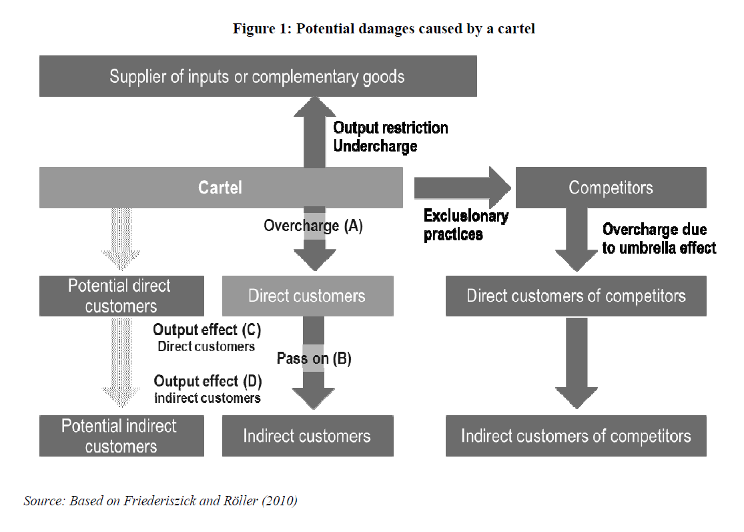
Potential damages caused by a cartel

Slide 57
The issue of compensation of antitrust damage must be related to the general principles of civil law
Are there legal principles such that « no enrichment without a cause » or « no double jeopardy » ?
Can there be « punitive damages » or must the harm be exactly compensated
Can the « indirect » harm be compensated ?
Must the competition authority « assess the anticompetitive harm » ?
Measurement Issues
Can there be a passing on defence ?
Does the court have to assess the importance of the passing –on?
How to assess the prejudice?

Slide 58
The causality condition
In Spain in the Conduit case, the claim followed a decision of the Telecoms regulator which established both a first refusal to supply data by Telefonica , and a supply of poor quality data afterwards, to Conduit in the telephone directory enquiries business.
(….)
To calculate the lost profits, Conduit estimated the market share the company would have reached in the Spanish market, had Telefónica supplied the correct data in due time. In order to do so, Conduit’s expert submission compared the Spanish market with the British market, where Conduit was also present. But the Courts challenged such assumption arguing that the conditions for Conduit in the British and the Spanish markets were far different (…).
Moreover, the judge refused the causality connection between the infringement and the damages. The judge argued that there were other elements, specially advertising costs, which were more important than the quality of the data provided in determining the market share of the entrant. Thus, the judge refused to award any compensation as lost profits.

Slide 59
Issues to be discussed
Economic thinking and legal thinking
The scope of competition law: Unfair practices, anticompetitive practices
Economic elements useful in competition law
Economic issues in assessing anticompetitive agreements
Economic issues in assessing the conduct of dominant firms
Relevance for Hong Kong competition law
Damages from anticompetitive practices
Ten principles to follow when presenting economic evidence to courts
How to facilitate the economic undertanding of courts ,
Conclusion

Slide 60
Ten principles to follow when presenting complex economic evidence to any Court
Explain underlying intuitions. One useful tool for providing the intuition behind complex economic concepts grounded in the empirical evidence.
2. Ensure that economic theories are grounded in the facts of the case.
3. Know and explain the limits of your data. (to be in a position to show that any apparent data deficiencies do not affect the overall conclusions.)
4. Carry out sensitivity analysis.
5. Employ (and develop) simple rules. (Economists also have an important role to play in explaining why the application of the rules will be appropriate in some cases, but not in others).

Slide 61
Ten principles to follow when presenting complex economic evidence to a Court
6. Use plain, non-technical language.
7. Where possible, draw on the established stock of economic theory, not the latest advances. (the latest advances need to be presented with caution and in context).
8. Make sure the economic case is well aligned with the legal case. In some cases, the economic and legal analyses are presented as more or less distinct sets of arguments, and can even make inconsistent assumptions.
9. Don’t try to use complex economics as a smokescreen for weak arguments. All you are likely to do is annoy the judge.
10. Ensure your expert witness is well prepared and doesn’t hector or talk down to the Judge.

Slide 62
Issues to be discussed
Economic thinking and legal thinking
The scope of competition law: Unfair practices, anticompetitive practices
Economic elements useful in competition law
Economic issues in assessing anticompetitive agreements
Economic issues in assessing the conduct of dominant firms
Relevance for Hong Kong competition law
Damages from anticompetitive practices
Ten principles to follow when presenting economic evidence to courts
How to facilitate the economic undertanding of courts ,
Conclusion

Slide 63
How to facilitate the economic understanding of civil courts ?
When courts retain their own expert in antitrust damages proceedings, there is a a need for the court to define the expert’s mission in a relevant way. Such a definition also requires the court to have a sufficient understanding of economics.
The question then is how to ensure that courts will have a sufficient level of understanding of economics to enable them to fully grasp the differences between the parties’ experts or to instruct their own experts. This is a challenge in civil law countries where judges (or lawyers) had, until recently, very little exposure to economics during their legal training.
There are three types of tools that can be used to increase the level of economic understanding of courts:
Institutional tools;
Procedural tools;
Methodological tools.

Slide 64
Issues to be discussed
Economic thinking and legal thinking
The scope of competition law: Unfair practices, anticompetitive practices
Economic elements useful in competition law
Economic issues in assessing anticompetitive agreements
Economic issues in assessing the conduct of dominant firms
Relevance for Hong Kong competition law
Damages from anticompetitive practices
Ten principles to follow when presenting economic evidence to courts
How to facilitate the economic undertanding of courts ,
Conclusion

Slide 65
Conclusion
Competition law is unique in that its implementation requires an understanding of the concepts underlying the economic analysis of markets so as to distinguish between prohibited and non prohibited practices.
At the same time, because it is a law, competition law cannot ignore the general legal principles applicable ( whether administrative or criminal or civil)
Therefore the courts adjudicating competition law cases or reviewing competition law decisions from competition authorities must understand enough economics to enforce competition law meaningfully.
But the competition economists ( and the competition authorities) must also undertand that they are part of the law enforcement system and that the judges will follow the general legal principles ( whether for due process, the requisite standard of proof, the burden of proof etc….) when applying competition law

Slide 66
Thank you very much frederic.jenny@gmail.com

